Slide 1
IBM Application Modernization

Slide 2
Application Modernization
Application modernization is business modernization
Accelerate Digital Transformations
Driven by need to build new capabilities and deliver them quickly
Application modernization is the transition of existing applications to new approaches on the cloud, helping you achieve the following business outcomes:
Speed to market
Rapid innovation
Flexibility
Cost savings
Improve Developer Productivity
Developer self service via adoption of Cloud Native architecture and Containerization
Increase Operational Efficiency and Standardization
DevOps enablement drives a culture of automation and transformation of operations

Slide 3
IBM’s Application Modernization Approach
Enterprises' existing estates determine the best journey to modernization
1
2
3
Increased Agility
Reduced Risk
Turnkey
Technology to:
Gather application inventory
Provide guidance on the journey to cloud
Enable infrastructure as code
Self service with IBM Garage Methods to help with modernization
Access to variety of proven approaches to modernize
IBM experts who have an understanding of your traditional applications and the business outcomes you need to achieve
Innovate rapidly by adding new capabilities to existing applications
Modernize at customer’s pace
Option to modernize applications at scale
BENEFITS

Slide 4


Application Modernization Framework
TODAY
Create – Connect - Optimize
TRANSFORMED
Analyze for Insights
Rehost
(migrate)
WAS
MQ
IBM
Private Cloud
IBM
Public Cloud
DB2
IIB
Replatform
(augment)
Portal
---
Day 2 Operations & Management
Refactor
(rewrite)
WebLogic
JBoss
---

Slide 5
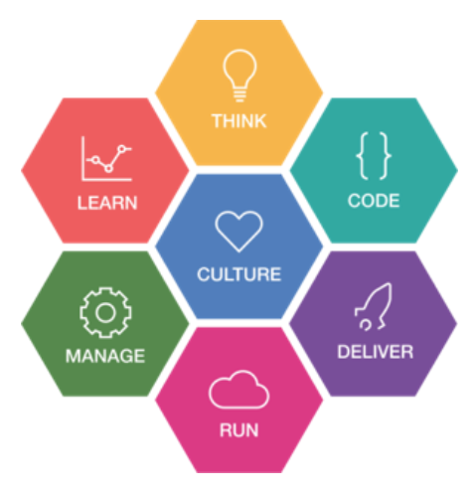
IBM’s AppMod Method
Modernize your applications quickly and safely using our accelerators and tools
Prescriptive Guidance:
An approach you can trust based on proven method
Thrive
Think
Technology:
Discover and automate deployment to speed time to market
Business value:
Accelerate value by leveraging existing estate
Transform

Slide 6



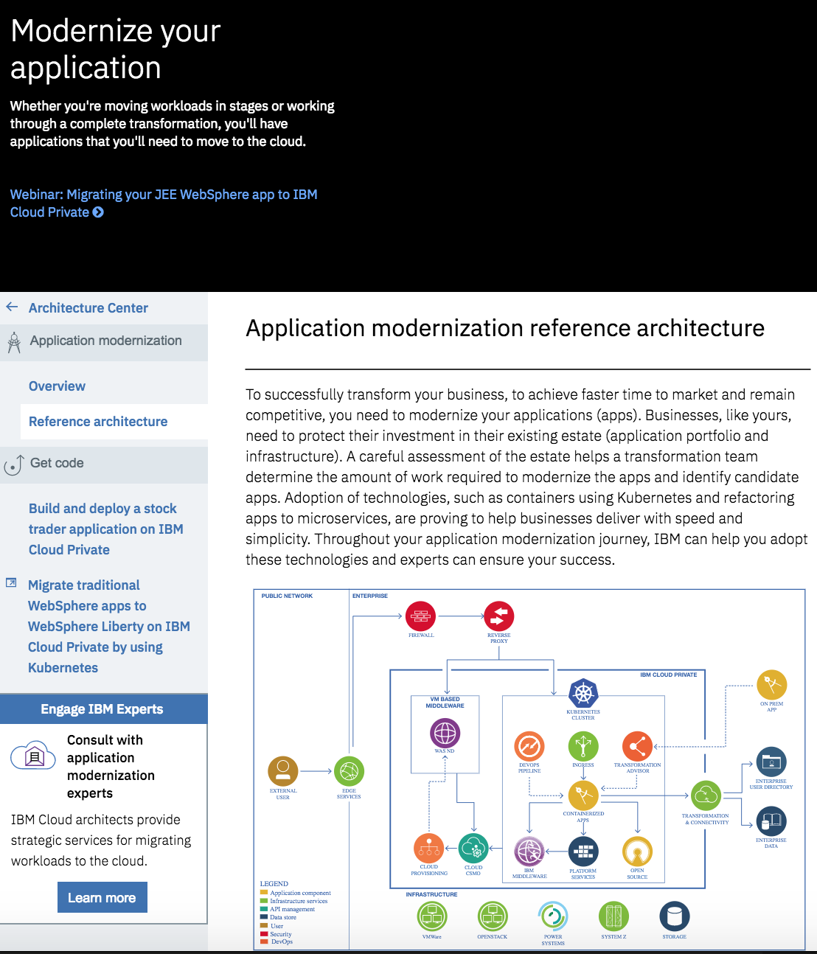








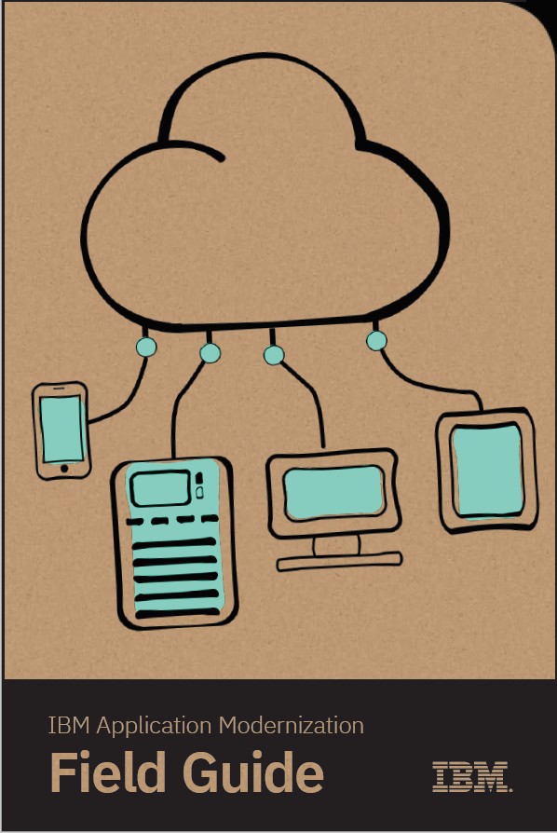
Prescriptive Guidance
IBM Cloud Garage
IBM Cloud Garage Method
IBM Architecture Center
newly announced
ibm.com/cloud/garage

Slide 7
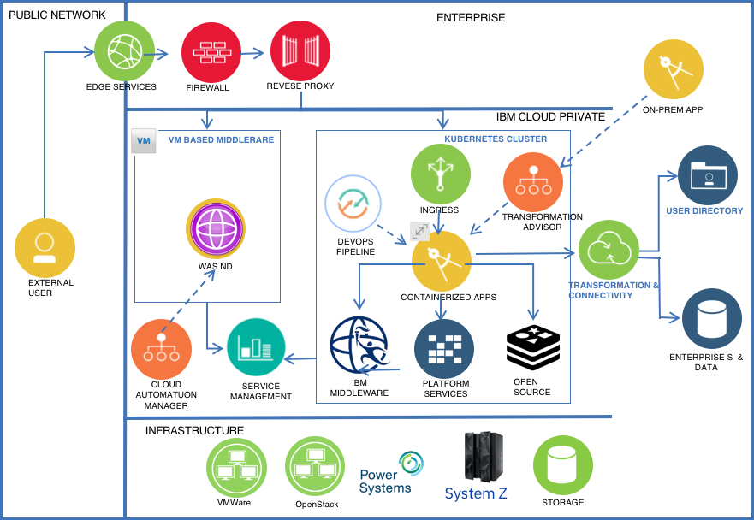
Reference Architecture for Application Modernization

Slide 8
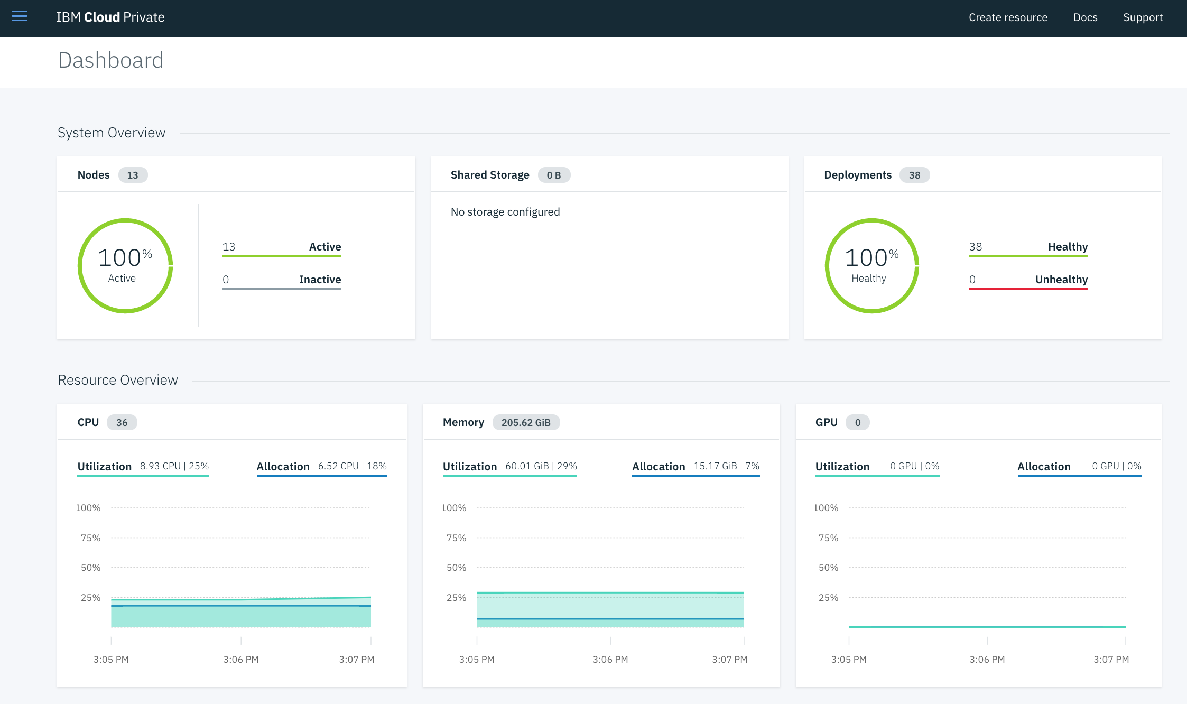
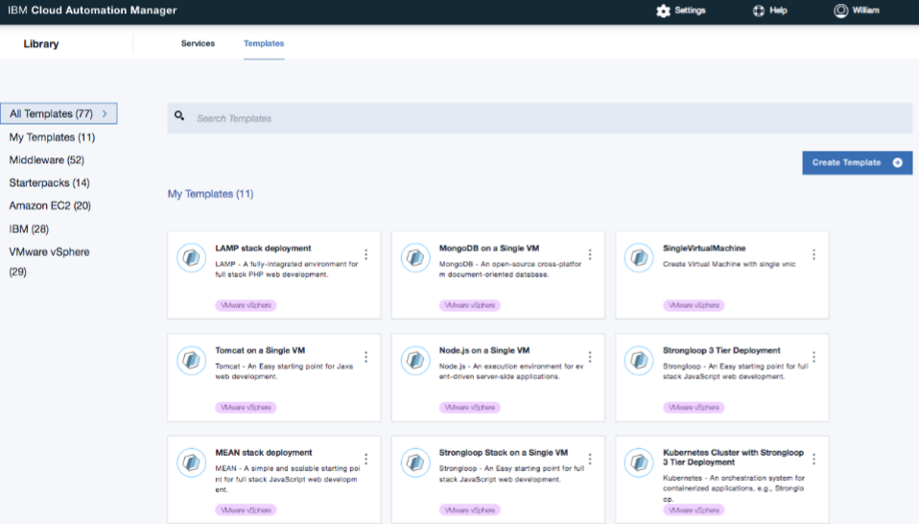
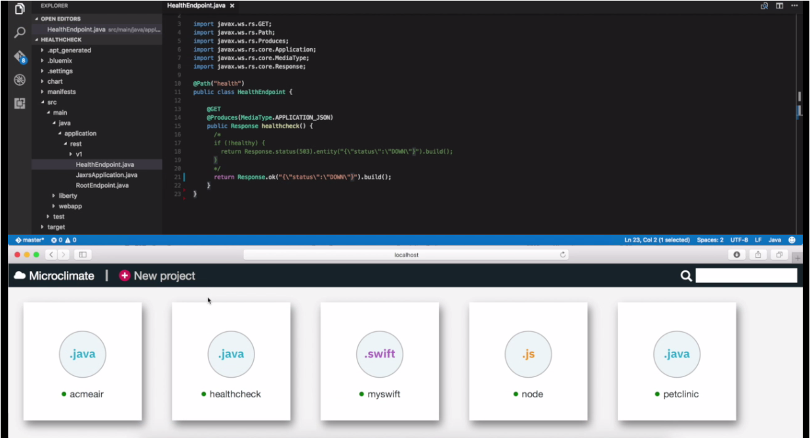
App Modernization Technology
Garage Method
Architectures, best practices, and toolchains to jump-start modernization
IBM Cloud Private
A transformative platform for building and running cloud-native applications and modernizing existing enterprise.
Transformation Advisor
Assess and Deploy traditional apps into IBM Cloud Private
Cloud Automation Manager
Multi-Cloud Provisioning
Pre-Built Automation Content
IBM Microclimate
End to end development environment that lets you rapidly create, edit, and deploy applications.
Cloud Production
Deployment Planning Production Environment Production Readiness Service Management DevSecOps Backup and Recovery

Slide 9
AppMod @3000ft
… microservices
Modernize Middleware
monolithic middleware →
containerized middleware
… microservices
migrate→
augment→
refactor
Modernize Apps
API integration
SOA→ Interaction APIs
… microservices

Slide 10
AppMod @3000ft
Modernize Apps

Slide 11


Why Containers for Application Modernization?
Todd
Operations / Admin
Responsible for infrastructure, security, and management of the environment.
Jane
Enterprise Developer
Responsible for modernizing existing applications and creating new Cloud Native Workloads.
Simpler, lighter and denser than VMs
Portable across different environments
Provisioning takes a few seconds, I can respond quickly to spikes in usage
Simple updates, zero app upgrade middleware updates
Self-healing with Kubernetes
Package my app and all its dependencies
Deploy to any environment in seconds, enable DevOps
Decreased time for development, testing, and deployment
Testing and bug tracking are easier because there is no difference between running locally, on a test server, or in production
Great option for microservices

Slide 12
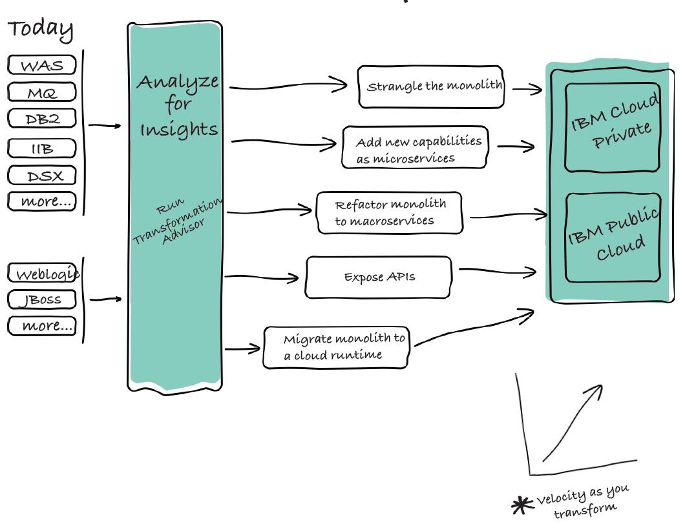
Application Modernization journey
Containerize the monolith. Reduce costs and simplify operations.
Expose on-prem assets with APIs. APIs enable legacy assets that are difficult to cloud enable.
Refactor into macroservices. Break down monoliths into deployable components.
Add new microservices. Innovate incrementally and establish success early.
Strangle the monolith. Incrementally sunset the monolith.

Slide 13
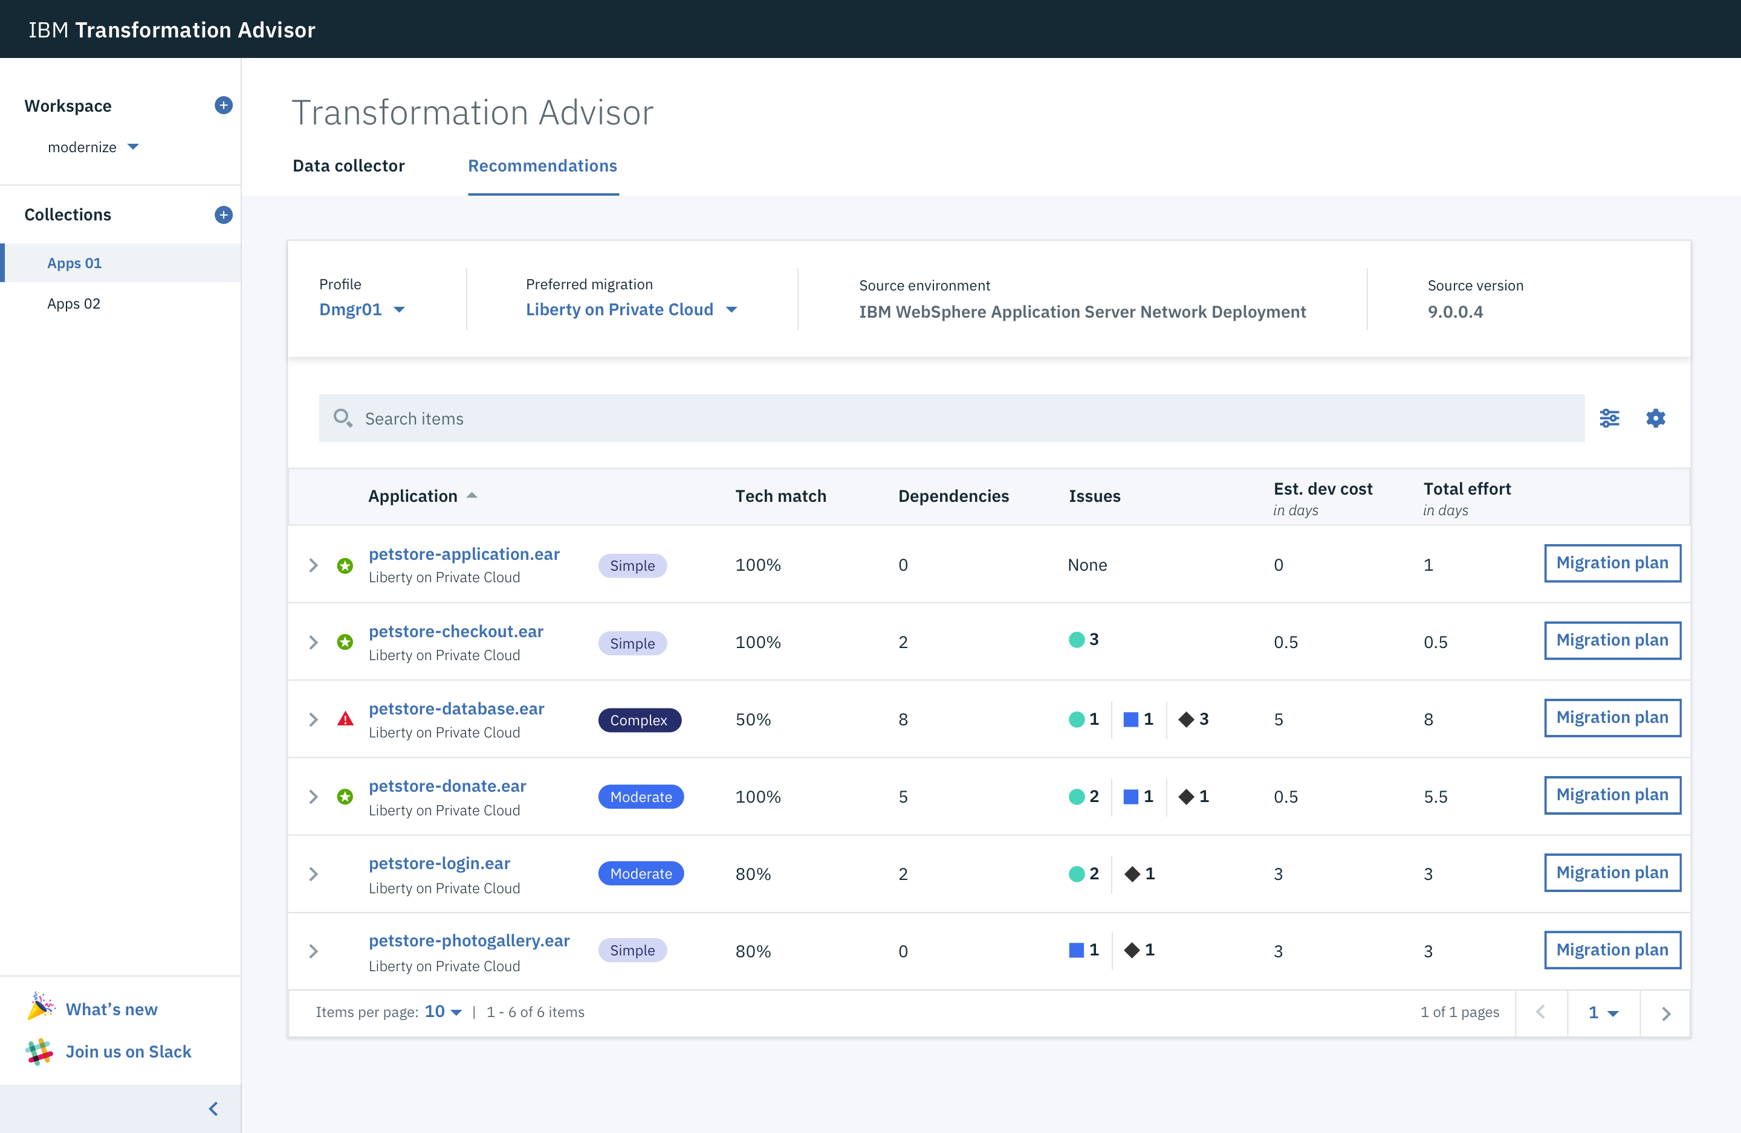
IBM Transformation Advisor helps classify existing apps based on their modernization complexity
Simple:
No code changes
Complex:
Continue to run in VMs
Moderate:
Some refactoring needed

Slide 14
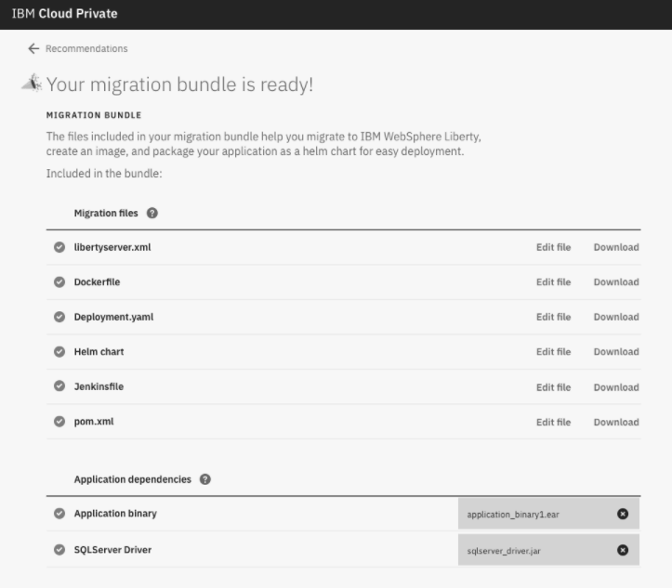
IBM Transformation Advisor generates artifacts to help you automate deployment onto IBM Cloud Platform(s)
Move to Liberty
Containerize

Slide 15

Containerized Monolith
Migrate
App
App
Migration
tWAS
Liberty
What
Why
Containerized runtime and middleware
As little application change as possible
Keep integrations and data on-prem
Self-service developer access
Runs on cloud
Small runtime/ Fast startup
“Zero” future version migration
Cloud portability
Lower operational costs (higher runtime density)

Slide 16
Fast Monolith
Augment
next gen UI
App
Refactor
REST
App
Cloud Services
Liberty
Liberty
DevOps
What
Why
Legacy is preserved, new capabilities added
Modern DevOps
Modern development tools
Accelerate delivery cycle: months → week(s)
Constant innovation
next gen UI experience
Cloud services

Slide 17
Scalable Monolith
Refactor
App
App
App
Migration
Autoscale
tWAS
Liberty
Liberty
What
Why
Augmented Monolith: 12 Factors
Data/integrations stay on-prem
Horizontally scalable
Platform provided HA
Substantial operational efficiencies

Slide 18
Macro-services aka “Microlith”
Refactor
App
MS1
MS2
MS3
Re-develop
tWAS
Liberty
Node
etc.
DB
What
Why
Break down application monolith into independently deployable modules
Data remains a monolith
“Half-way house” to microservices

Slide 19
Microservice
Refactor
App
MS1
MS2
MS3
Re-develop
tWAS
Liberty
Node
etc.
DB

Slide 20
Example: Refactoring a Monolith to Microservices
Original architecture
Single relational DB Schema
Products, Customer, Ordering, etc.
Single deployment unit (EAR file)
Business Problems
Limited searching capabilities for products.
Little knowledge of customer for targeted experience
Ordering system is complex
difficult to add product and customer analytics to site without breaking Order System.

Slide 21
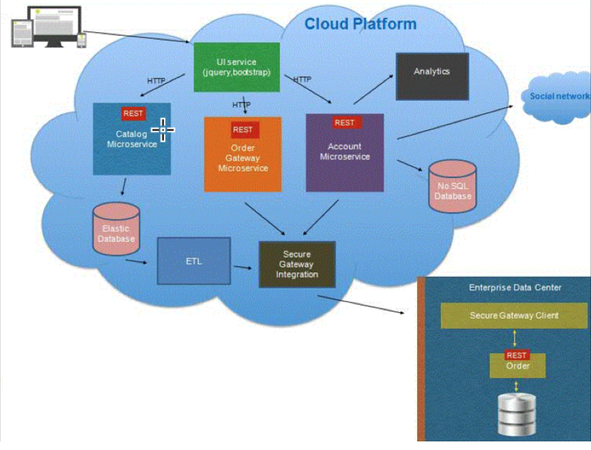
Modernization Outcomes
Catalog data imported into Elastic Search.
Clients delighted by new fuzzy search
Customer data modeled and stored in Document NoSQL store with analytic and social data
Improved targeted experience
Order microservice wraps on-prem ordering and uses integration.
Omnichannel functions:
New Mobile App uses new microservices.
Existing Website used with routing /
Strangler pattern to evolve.

Slide 22
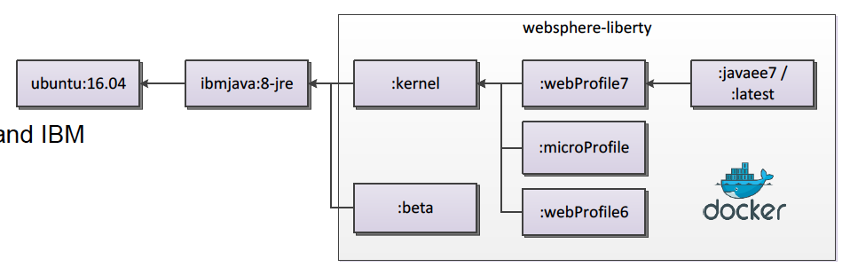

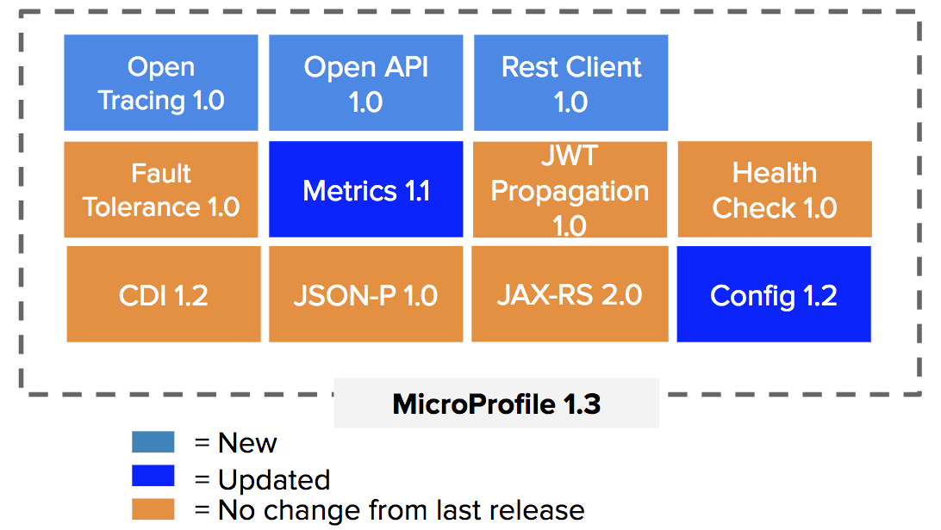
Why WebSphere Liberty?
Migrate to Cloud enabled full Java EE7 runtime
Migration automation and acceleration with Transformation Advisor
Modernize with MicroProfile for microservice refactoring
Open Liberty - open source Liberty with with Java EE7 and MicroProfile capabilities
IBM Confidential / InnerCircle / Think 2018 / 7973 / March 19, 2018 / © 2018 IBM Corporation

Slide 23
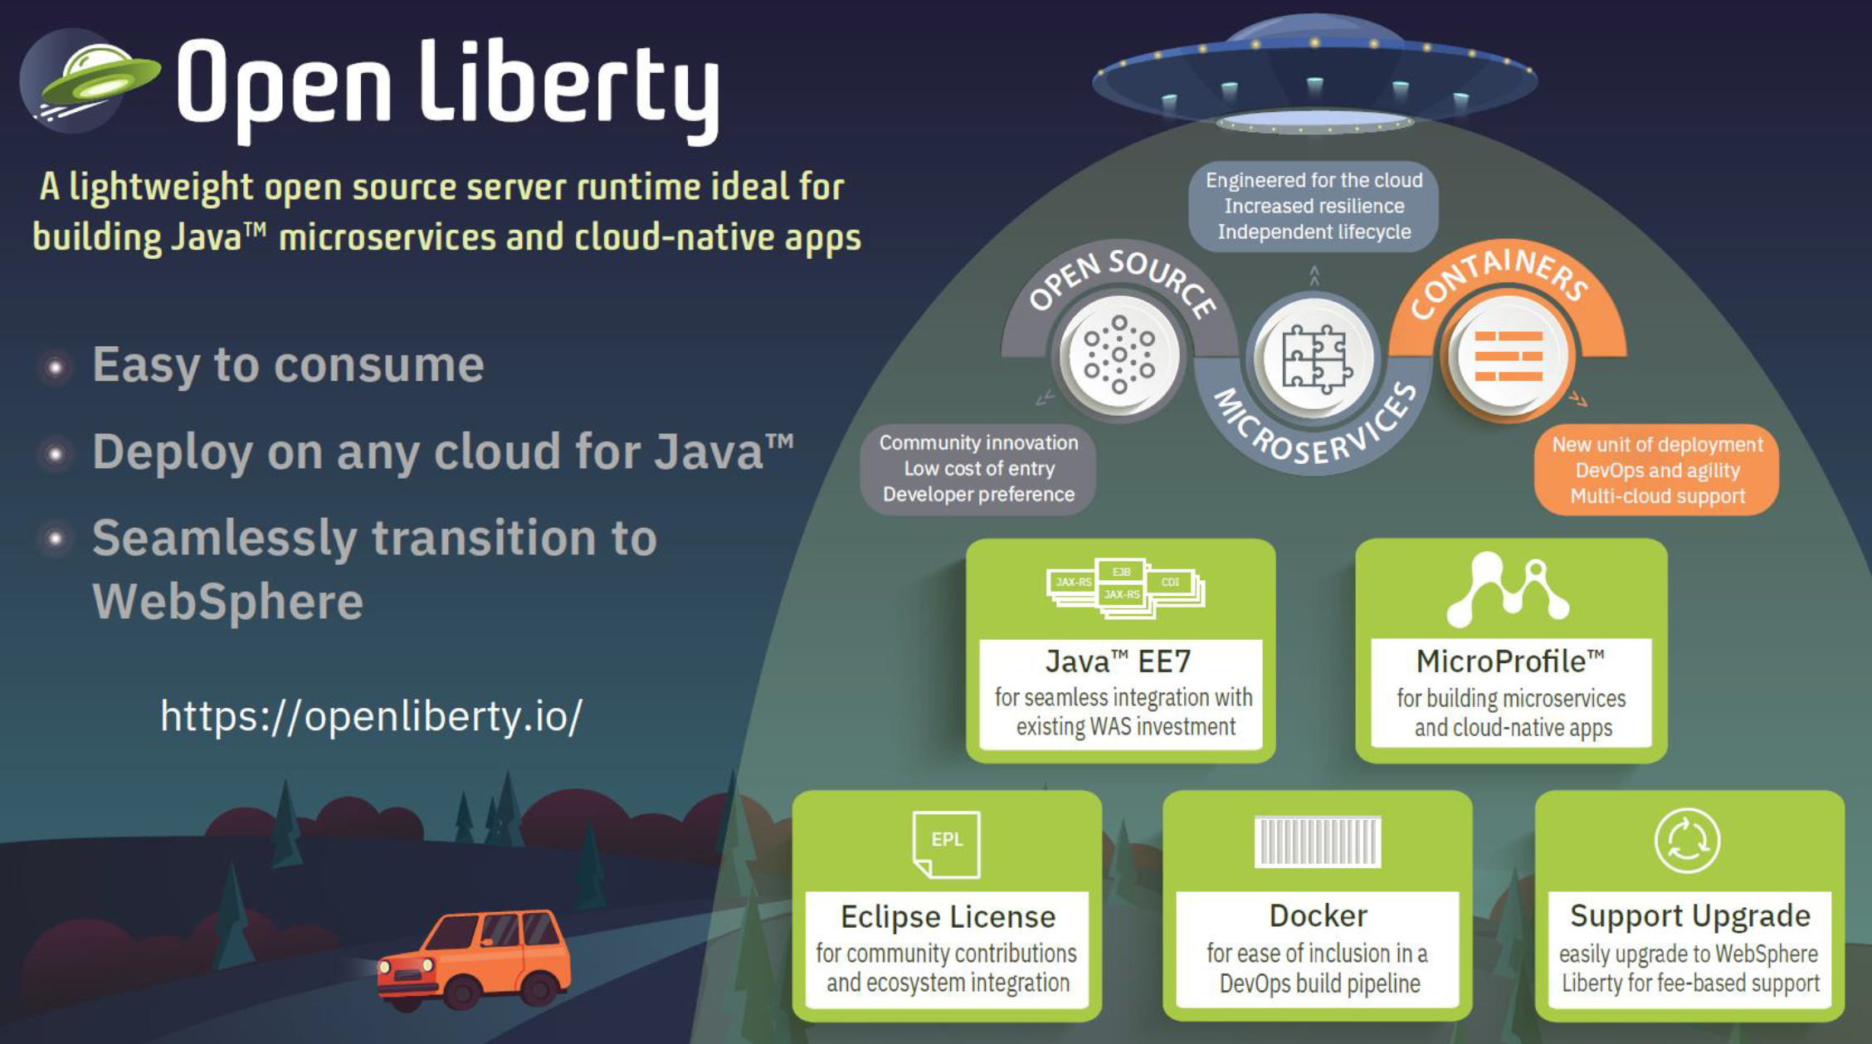

Slide 24
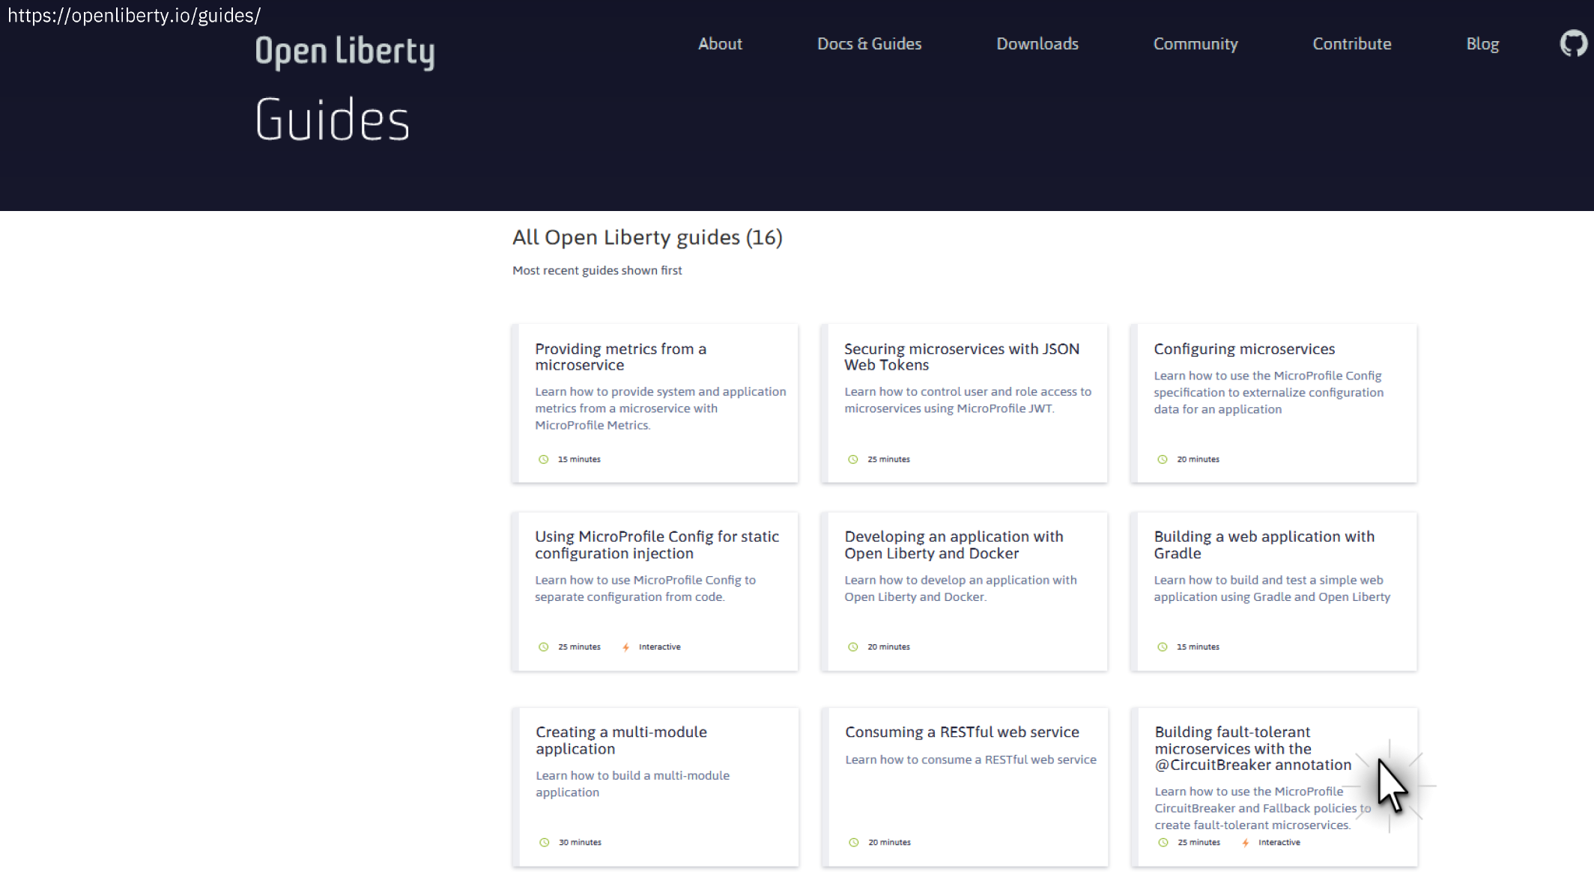

Slide 25
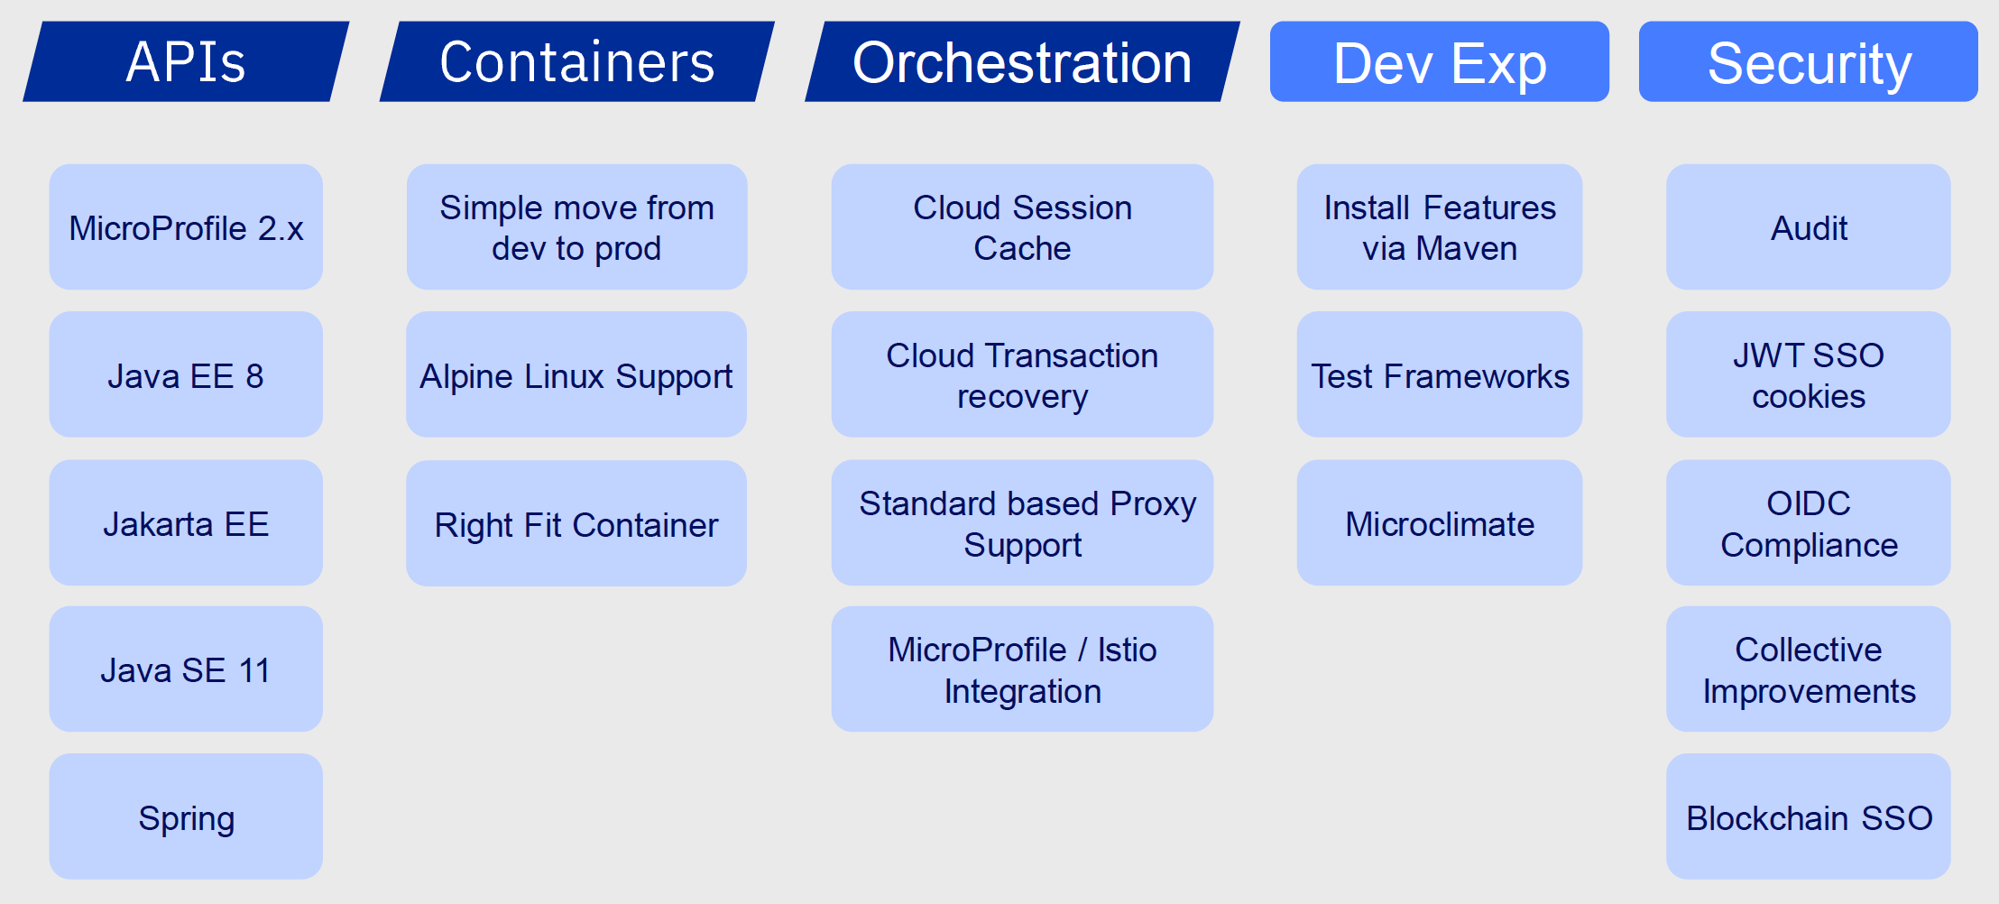
Liberty - futures
IBM CONFIDENTIAL

Slide 26
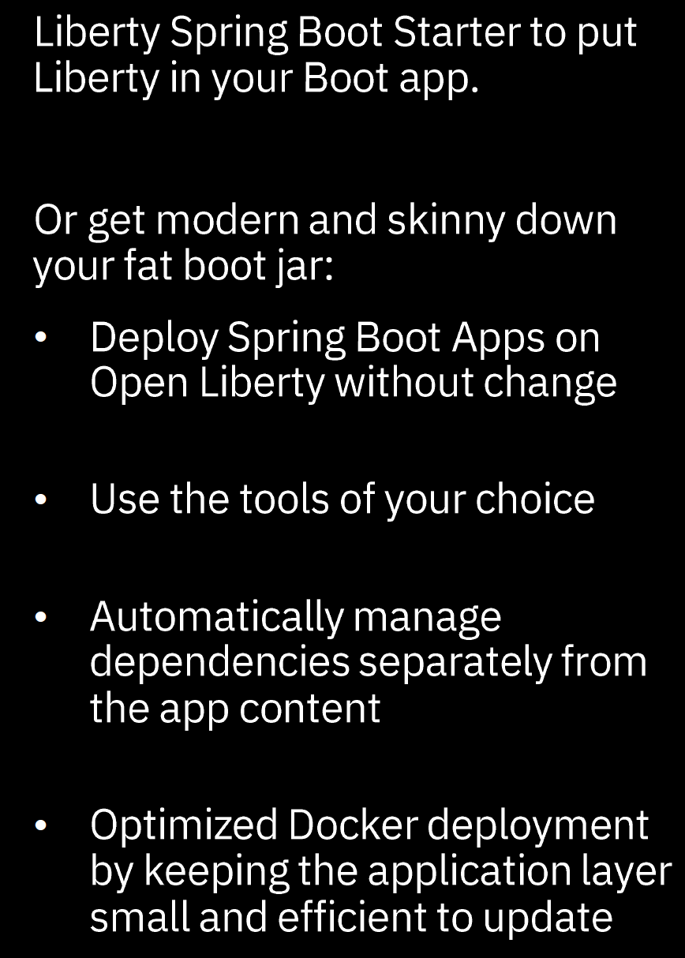
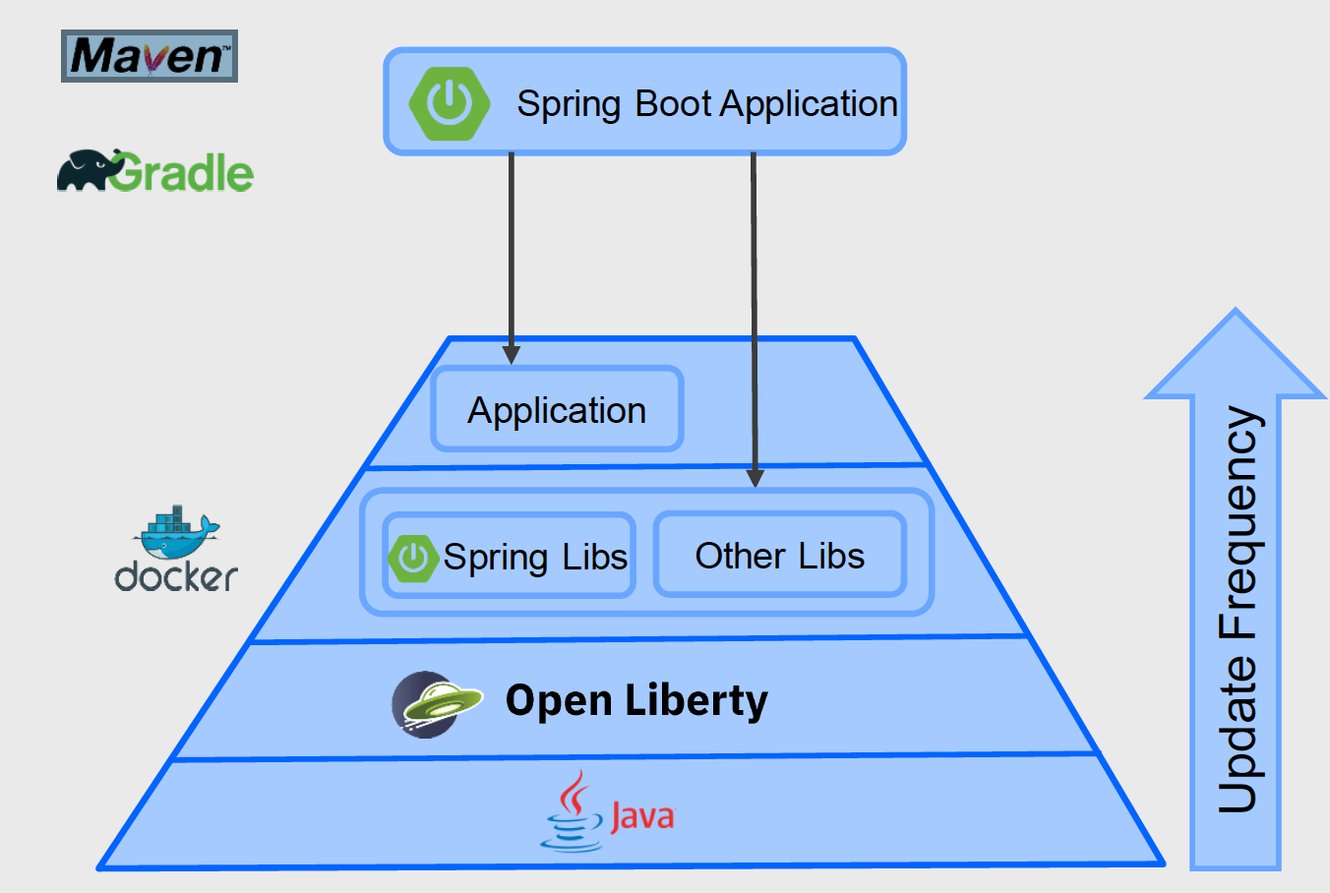
Spring Boot Applications on Liberty

Slide 27
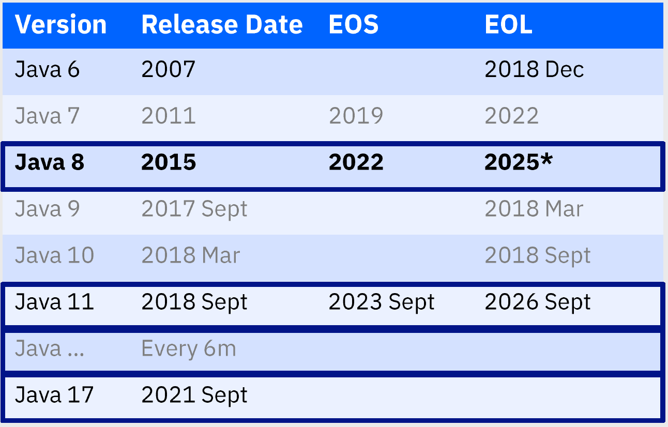
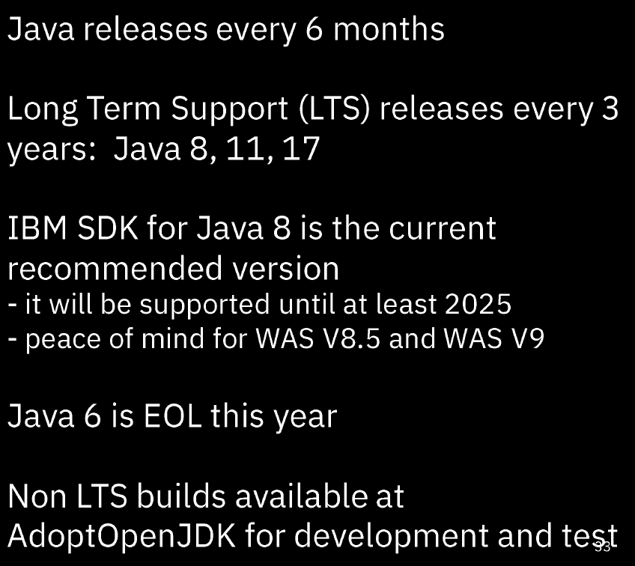
Java release roadmap

Slide 28
AppMod @3000ft
Modernize Middleware

Slide 29
Traditional Middleware Deployment “Hairball”
App A
App B
other on-prem systems
.. is what business calls “an app”
QM
DB
Local
Remote
Local
Remote
Data hairball to rule them all

Slide 30
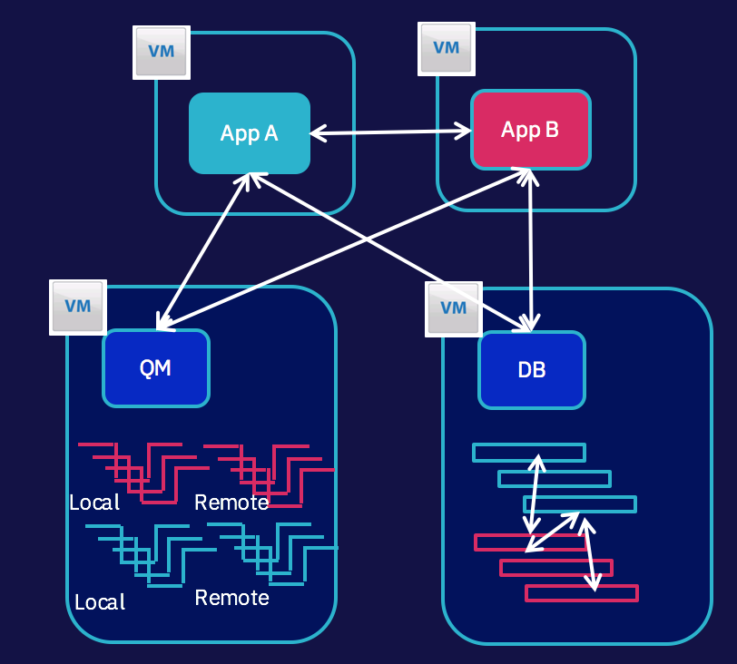
Untangling the Hairball with Containerized Middleware microservices
App A
App B
QM
QM
Local
Remote
Local
Remote
DB
DB

Slide 31
Deploying Containerized Middleware
MUST HAVE DEVOPS!!
Docker Repo
Docker Repo
Helm
Helm
Middleware images
Middleware images
Kube
Private Docker Repo
Kube
Build Image
Git
Modifiable container
Git
Immutable container
Dev
QA/Prod
Code/Config
Code/Config

Slide 32
App is MQ Client Traditional Setup
Mainframe
QM1
Send channel
Receive channel
QM2
App A
Receive channel
Send channel
App B
Active
Passive Standby
Shared Storage

Slide 33
Disentangled Messaging – MQ “microservices”
Pod
Pod
AppA
AppB
Pod
Pod
MQ-A
MQ-B
Legacy
MQ
on-prem
What
Why
Un-share MQ servers
Use dedicated MQ containers for each app client
Failover is just rescheduling MQ pod
Running containers are immutable
Can’t have “MQ admin” manage queues in running instance

Slide 34
Modernize cloud development experience with enterprise middleware microservices
App A
REST API
don’t want MQI, JMS
just need a queue endpoint
advanced MQ TL;DR
new MQ REST API in 9.0.x
QM
Local
Remote
Unbeatable QoS

Slide 35
AppMod @3000ft
API Integration

Slide 36

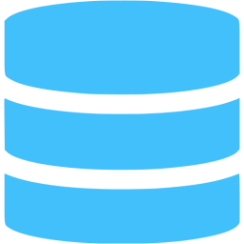

Digital Apps Present New Integration Challenges
Traditional web apps
If digital apps used same approach…
Digital apps live in the internet (phones, IoT, dynamic web pages)
High latency make traditional integration approach untenable.
Can’t simply reuse existing services for new digital apps – need a new approach
TH
GS
browser
IN
Single response sent back to client
Digital App
3
request
1
Open internet
Enterprise
High latency, low bandwidth
2
Many calls are made, often w/ large payloads.
All within local network, so this worked
Web App
Low latency, high bandwidth
ESB
ESB
Notes:
I want to ensure that you understand an important difference in digital applications vs. traditional applications.
In traditional applications, you generally had a web server/app server/portal running in the datacenter, which had a fat pipe (high bandwidth, low latency) to the systems of record it needed to access in order to serve requests. This meant that developers could be “efficient” (or lazy) in terms of how much code they wrote. Let’s say they wanted to build an app that needed to know if the user was allergic to peanuts. There was probably a service on the backend that would return a patient’s health record….a 5MB file full of information. But we only need 1 bit – a boolean saying True/False – allergic or not. These developers didn’t care, because it didn’t impact their performance meaningfully, and it was easier to just use what’s available vs. Going thru a 6 month waiting period to get the IT folks to build them a new service. So, the app would go back and forth a ton, download a ton of info, throw away most of it, and send it back to the client.
Now, apply that in a digital world where the app runs on a phone, or in a cloud far away from the SOR’s, or on an IoT device. The same approach doesn’t scale. You have...you guessed it....2 options:
1] You could ask the folks who own the backend IT systems to create a new request to get peanut allergy status. Of course, that’ll be ready 8 months from now (remember, central IT is measured on uptime, resiliency, and have rigid processes designed to protect those)
2] You can add a new tier between the app and the systems of record which is owned by the digital team, and resides inside the enterprise w/ a fast pipe. Next slide please.

Slide 37
Digital Applications Require a new Interaction Tier
Digital Team / Line-of-Business
Measured on time to market. Motivated to be fast (e.g. “get it out, fix it in market”).
Can’t simply call existing System API’s from digital apps for performance reasons (see previous slide)
Can’t afford to wait weeks/months for a new System API that exactly meets their needs
Needs a NEW tier which sits close to the systems of record, but is controlled by the Digital Team/LoB
www
TH
GS
IN
App
Edge of Datacenter
Interaction API
Central IT Team
Measured on resiliency & uptime. Motivated to be cautious. Generally takes weeks/months to turn around change requests (e.g. to support digital apps), due to change control & quality control processes.
System API
System API
Web Service
ESB
Notes:
Obviously, option 2 is the best. But this has implications. You need an offering which helps you create and protect this new tier. Luckily, IBM has catapulted itself to the #1 position in the API market based in large part on its ability to do this uniquely well. API Connect allows you to discover systems of record, and quickly generate and customize code that accesses them. Then, it allows this code to be managed in concert with the other aspects of API Management. For example, API Connect keeps your swagger definitions, gateway configurations, developer portal docs, and API manager configurations in sync as you update your API code. It also provides an enterprise grade runtime environment for these APIs to run. Finally, it includes API Gateway options (either DataPower or an embedded micro gateway) which allows developers to easily customize the gateway in front of their apps.
This new tier is recognized by analysts as the interaction tier. And IBM is recognized as the leader in the space.

Slide 38
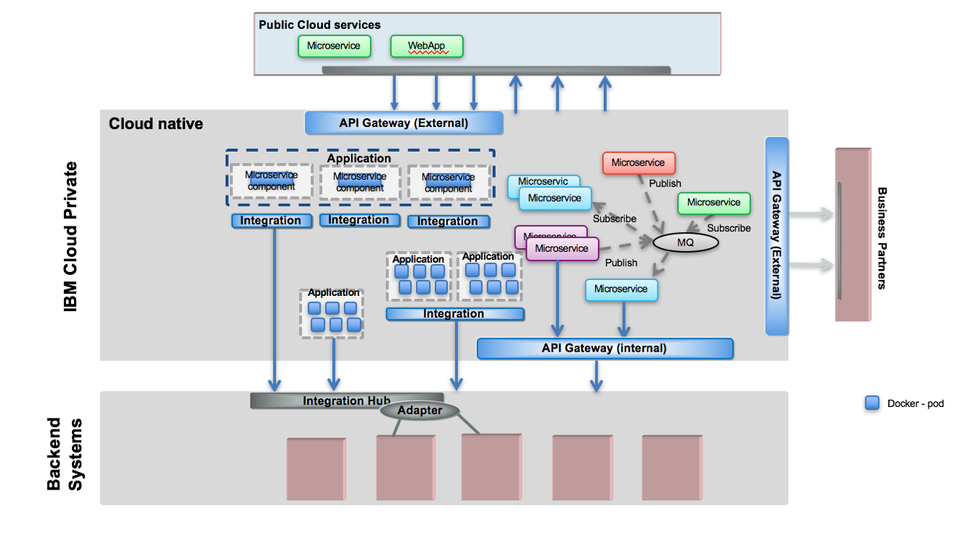
API Integration Patterns

Slide 39
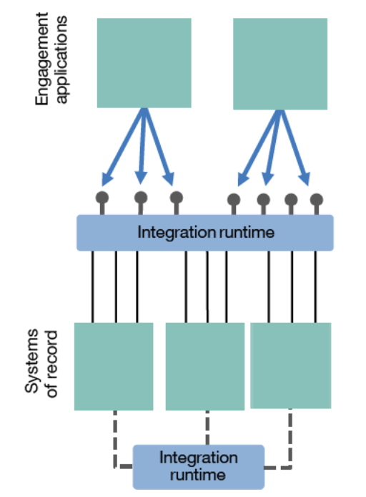
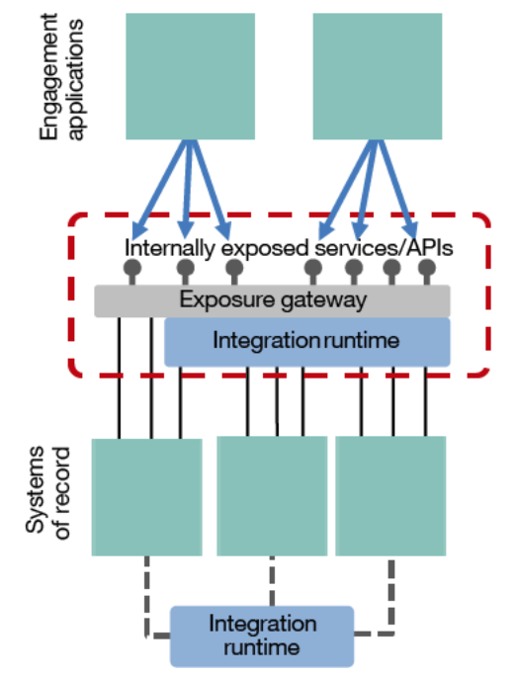
Enhancing existing ESB pattern
Augment
https://www.ibm.com/developerworks/cloud/library/cl-lightweight-integration-1/

Slide 40
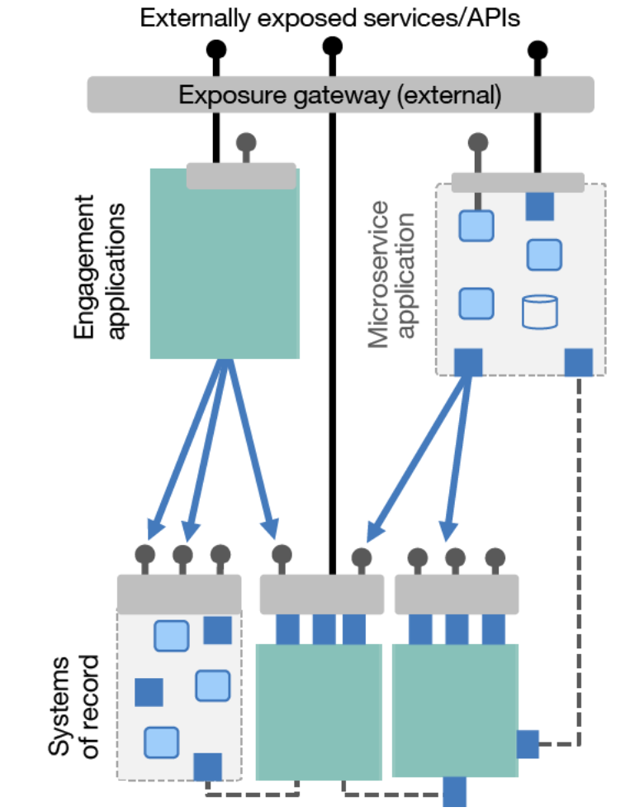
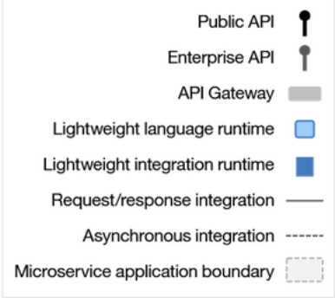
Breaking up the centralized ESB into independently maintainable and scalable pieces
Refactor
https://www.ibm.com/developerworks/cloud/library/cl-lightweight-integration-2/

Slide 41
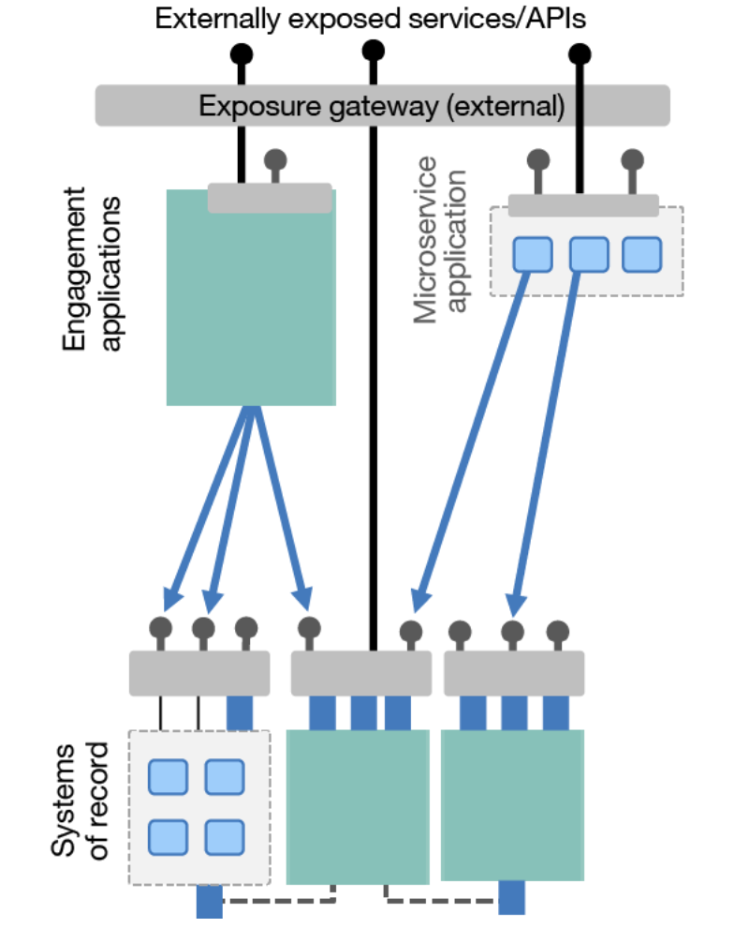
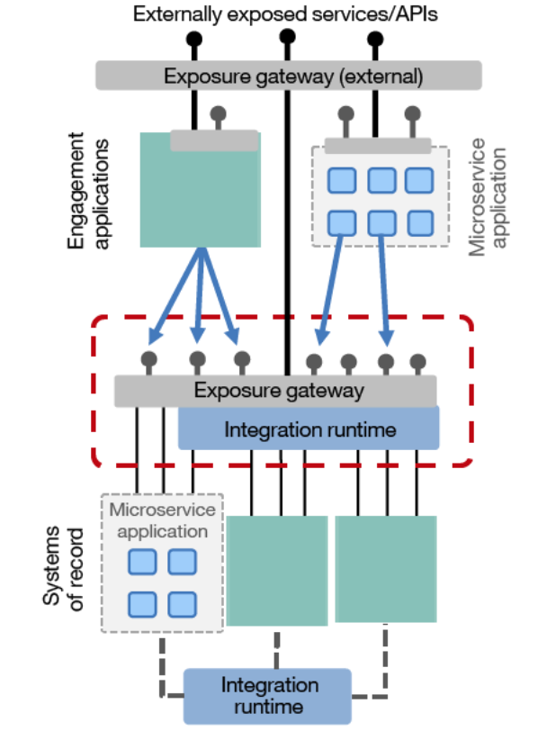
Decentralized integration ownership

Slide 42
AppMod @3000ft
Summary

Slide 43
IBM Accelerates your Cloud Adoption Journey
Analyze for Insights
IBM
Cloud Private
WAS
MQ
DB2
IIB
Portal
---
IBM
Public Cloud
WebLogic
JBoss
---
Notes:
Start with IBM Transformation Advisor to understand your inventory and to select the best entry point into your modernization journey.
Deliver value at each step of the journey
Outcomes are accelerated as you progress thru the journey
GET FIRST RESULTS IN WEEKS
Containerize the monolith to Reduce costs, simplify operations
Expose on-prem assets with APIs. Build APIs for your legacy assets that will not move to the cloud
Refactor into macroservices. Break down monoliths into deployable components
Add microservices Innovate incrementally, establish success early
Strangle the monolith Sunset the monolith incrementally

Slide 44
Garage Services for Application Modernization
Get a functional private cloud
Move application to cloud: Your developers will begin learning the IBM Cloud Garage Method by engaging in experiential learning as you work side-by-side with IBM SMEs to modernize applications
Learn the best tools and techniques to operate the newly modernized cloud application including an analysis of current operations, runbook review, and management dashboards
Using IBM’s Cloud Transformation Advisor tool , understand the applications in the environment, components, technology stack, functional and non-functional, dependencies and processes
Prioritize candidates (based on assessment) for immediate migration based on application information, value to the business and assessed complexity
Discover & Assess
You get:
A high level assessment of your overall application portfolio w.r.t readiness for modernization
Application Modernization
You get:
IBM Cloud Private (ICP ) + DevOps toolchain setup in non-prod environment with Minimum Viable Product for migrating containerized apps to ICP ( may include some re-factoring and/or re-platforming ).
Modernize & Operationalize
Competency & Deep Skills
Enablement Choices : Mix and match one week of training, choose from offerings:
Option 1: ICP BootCamp
Option 2 : Management and Ops enablement
Option 3 : Cloud Native App Dev
You get:
Choice of enablement based on your skills transformation needs

Slide 45
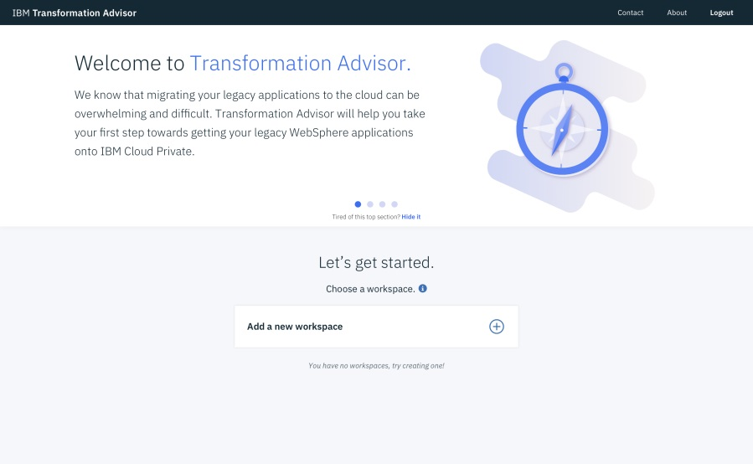
IBM Transformation Advisor
Collects information about your existing WebSphere Environment and Applications, combines that with rules and insights gained from years of working with WebSphere and WebSphere applications, and provides recommendations for your cloud journey
CHALLENGES ADDRESSED
Leveraging existing application logic
Need to accelerate application development and maintenance
Monolithic applications that are complex and tightly coupled
BENEFITS
Included and deployed on IBM Cloud Private
Introspects existing WebSphere Deployments
Provides recommendations, guidance and artifacts for deployment in Liberty containers and Kubernetes clouds
https://developer.ibm.com/app-modernization/

Slide 46
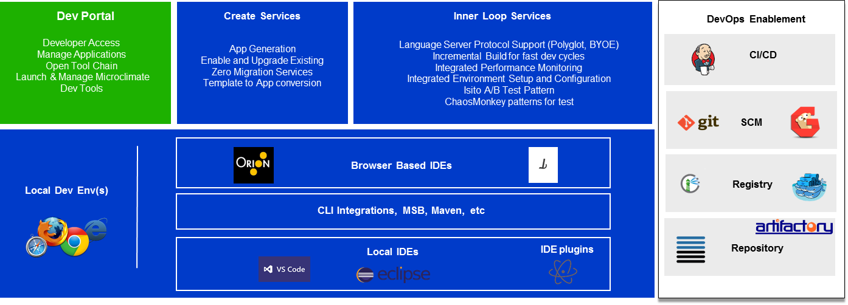
IBM Microclimate
Microclimate is an end-to-end development environment that lets you rapidly create, edit, and deploy applications. Applications are run in containers from day one and can be delivered into production on Kubernetes through an automated DevOps pipeline using Jenkins.
LEGEND:
ICP
Microclimate Local or ICP
Option for 3rd Party

Slide 47
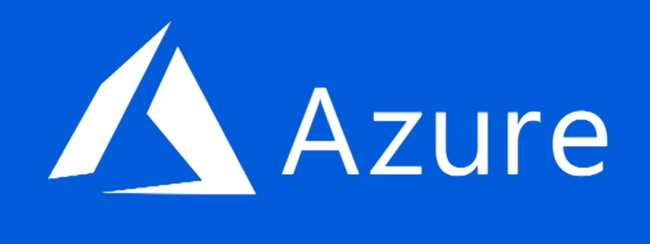

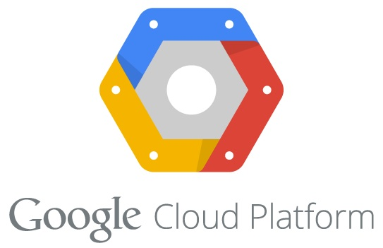



IBM Cloud Automation Manager
Deployment & Process Orchestration
Service & Template
Library
Enables infrastructure as code
Provides operational modernization for traditional WebSphere applications
Leverages IBM Cloud Private services for enterprise capabilities
3rd Party Integrations
Service
Composer
Flow Engine
Template Management
Instance Management
Template API
Workload
Terraform
Helm
Service
Public, Private & Hybrid Clouds
IaaS Management
IBM Cloud Private
Service catalog
Multi-cloud
Services
Infrastructure
Data & Analytics Services
Core Services
Kubernetes
Databases
Analytics
CAM
IAM
Logging
Audit
API & Data Connect
Encryption & Key Management
Monitoring
Usage
Metering
Event
Tenant Svcs

Slide 48
References
IBM Transformation Advisor - https://developer.ibm.com/app-modernization/
Microclimate - https://www.ibm.com/us-en/marketplace/microclimate
WebSphere Liberty - http://wasdev.net/
IBM Cloud Automation Manager (CAM) - https://developer.ibm.com/cloudautomation/
Free online Garage Method Courses - https://www.ibm.com/cloud/garage/content/course/websphere-on-cloud-private
IBM App Modernization Field Guide - https://www.ibm.com/cloud/garage/content/culture/app-modernization-field-guide/
WebSphere Application Server Migration Toolkit - https://www.ibm.com/developerworks/library/mw-1701-was-migration/index.html

